Slide 1
Homework #1
Gage Gutmann

Slide 2
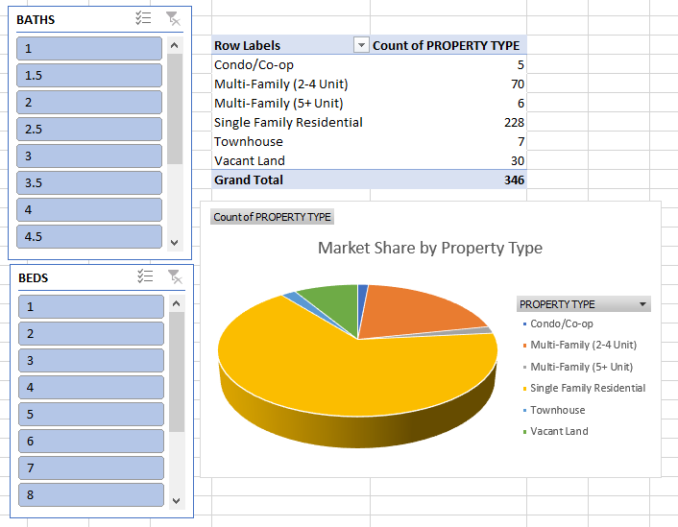
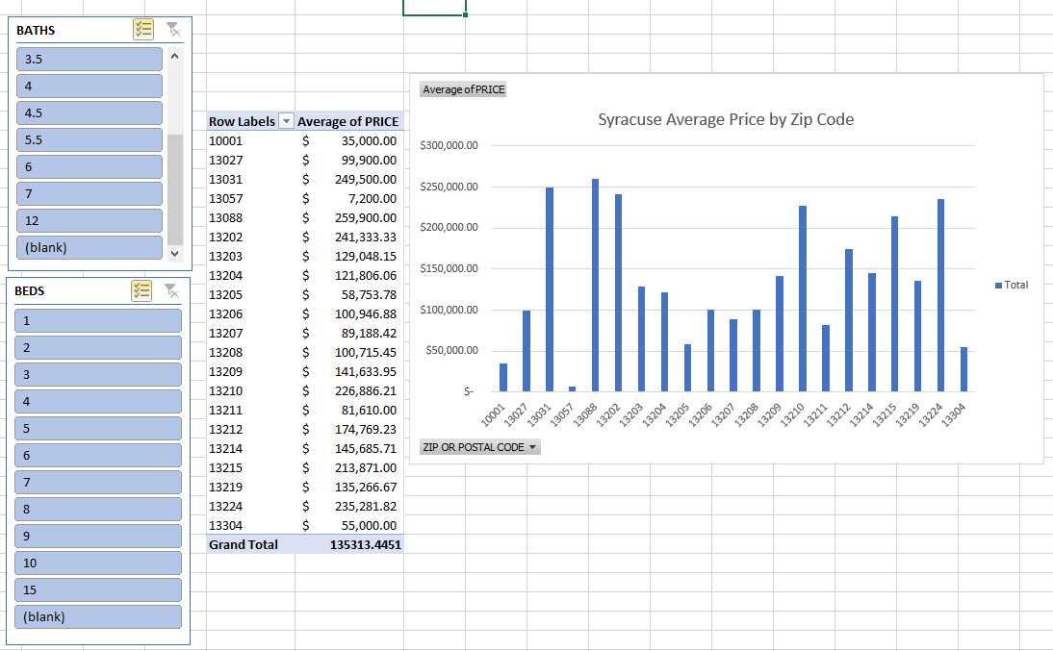
Zip Code and Property Type Analysis
Zip Code Analysis
Property Type Analysis

Slide 3
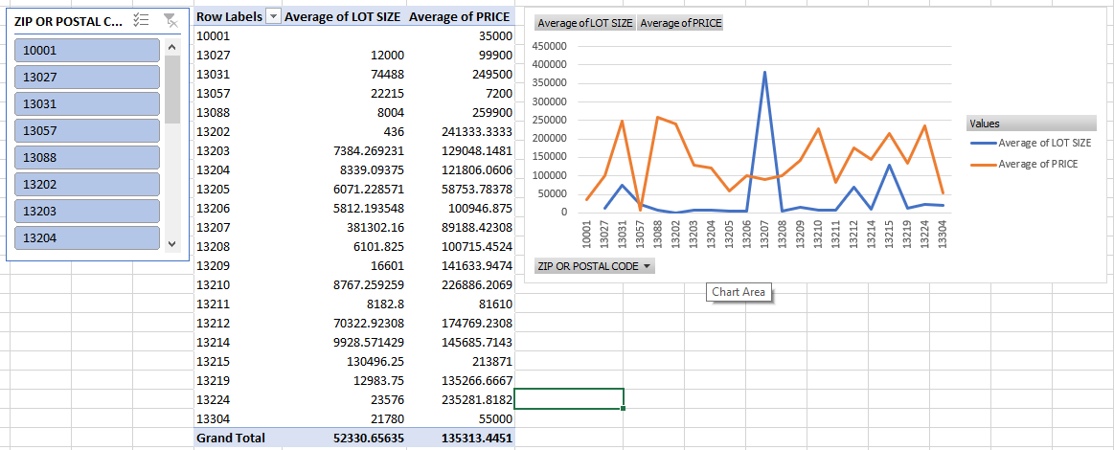
Lot Size and Price Analysis

Slide 4
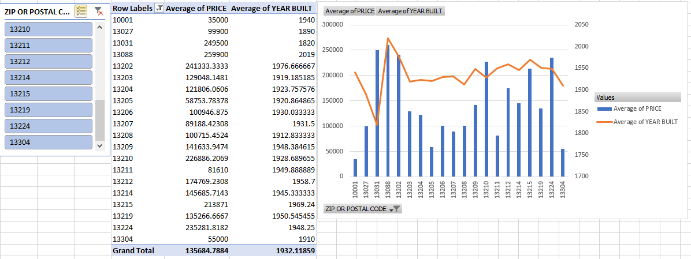
Year Built Analysis

Slide 5
What is the best zip code to look for a house in Syracuse?
A customer wants a good lot size to price ratio
But, they also want a house that is not too old so that they don’t have to do too much maintenance.
They are open to different prices as well as the type of property, as long as they are able to get a good deal, but would like if they could get a low price as well.
Let’s look at different zip codes, first taking into account the lot size to price and the year built.
From there we can narrow down zip codes to look at average prices and the type of property.

Slide 6
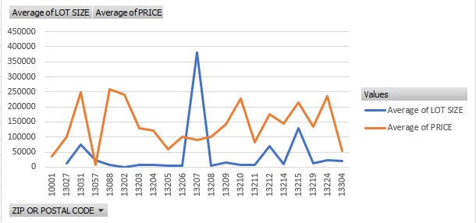
Looking at the average lot size with the average price per zip code, we can look where the two lines are closest together.
Zip code 13207 is a possible outlier.
However, zip codes 13212 and 13215 look close together…

Slide 7
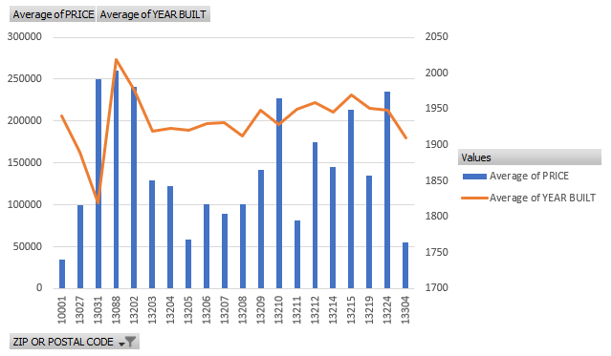
If we look at this chart of average year built with price, we can compare again where the two lines are closest.
Zip codes 13808 and 13202 seem ideal for this average year built and price.
But we can also see our previous zip codes 13215 and 13212 are close together as well.
Although 13808 and 13202 are ideal for this chart, 13215 and 13212 are good for both.

Slide 8
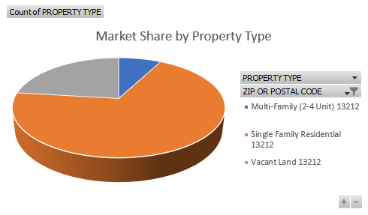
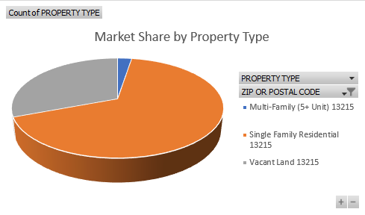
Property Type Comparison(Filtered by Zip)
13212
13215
Has more Single Family Residentials as well as Multi-Family
Has more Vacant Land to build upon

Slide 9
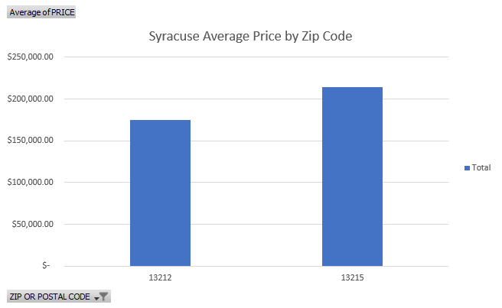
Average Price
The price of these two are similar when compared to each other, but looking closely, 13215 has an average price of almost $50,000 more, which might be a big deal for some.

Slide 10
Conclusion
The best two zip codes based on Lot Size and Year Built are 13212 and 13215.
When compared, 13215 has a slightly higher average year built and lot size.
However, it does have less options in regards to property type, and has an average cost of almost $50,000 more than 13212.
Because of more potential options and pricing, 13212 would be the better and safer option to look for a house.

